Slide 1
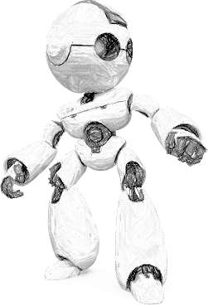
MUST ACADEMY – Image Processing and Computer Vision
By Aditya Bhattacharya
Lead AI/ML Engineer,
West Pharmaceuticals
MUST Research

Slide 2
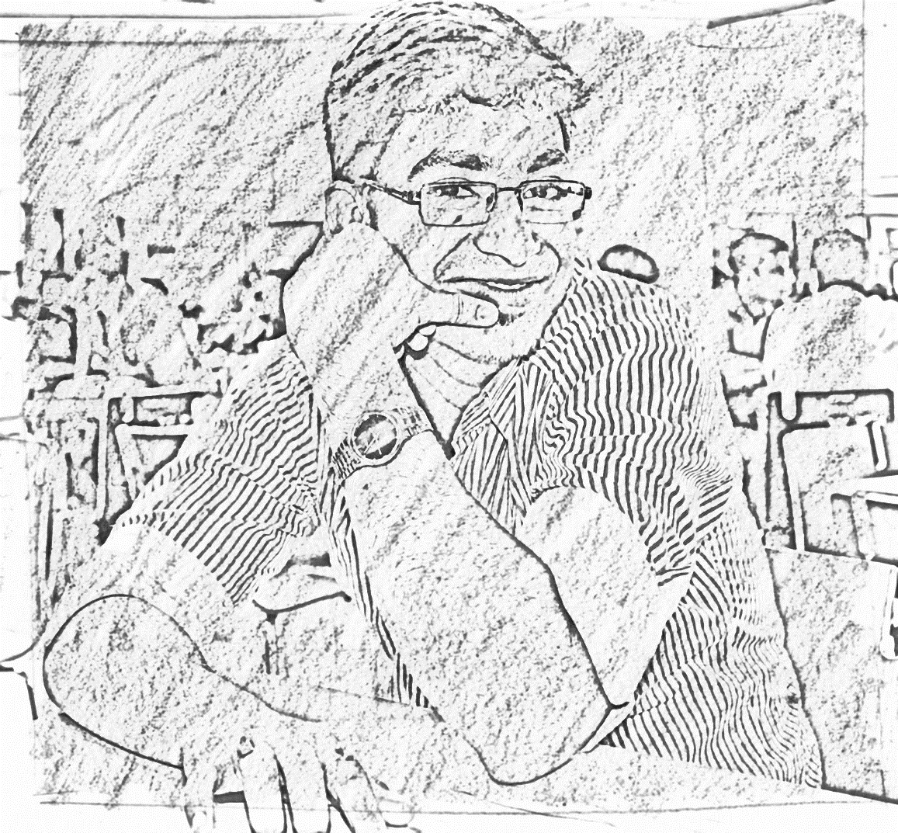
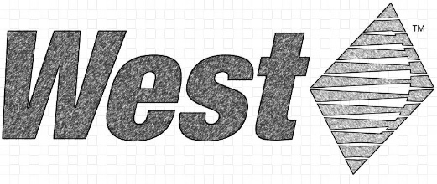

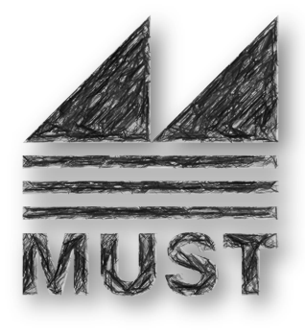


About Me
My Associations
My Interests
Aditya Bhattacharya
Lead AI/ML Engineer, West Pharmaceuticals
AI Researcher, MUST Research
https://aditya-bhattacharya.net/

Slide 3
Topics to be discussed
Hour 1: Getting started with computer vision (Introduction and Setup)
Images as Functions and Matrices
Mathematical operations with images.
Image Filtering.
Noises In Images.
Image Transformation.
Hour 2: Computer Vision ImageOps
Edge Detection
Colour Masking
Template Matching
Shape Detection

Slide 4
Topics to be discussed
Hour 3 – Computer Vision ImageOps 2
Convolution vs Correlation
Image Binarization
Image Morphology
Image Boundary Issues
Hour 4 – Exploring the world of deep learning
Introduction to CNNs
Multi-Class Classification using Images
Advanced computer vision deep learning concepts – Neural Style Transfer and GANs

Slide 5

Challenges!
Challenge 1 – Creating transparent pencil sketch portraits from original images.
Challenge 2 – Traffic Sign Detector from animated and real-world images.
Challenge 3 – Localization of bar codes and QR codes in images.
Challenge 4 – a - Brain haemorrhage segmentation from CT Scan Images using Mask RCNN
- b - Object tracking from video - Track the cricket ball from the given video

Slide 6
Environment Setup!
Please install Python 3.7 or up with the following packages :
opencv: 4.2.0
numpy: 1.18.4
matplotlib: 2.2.2
pandas: 0.23.4
keras: 2.2.4
tensorflow: 1.13.1

Slide 7
Let’s get our hands dirty!

Slide 8
Useful Links!
https://github.com/adib0073/MUST_ACADEMY-Computer_Vision
https://aditya-bhattacharya.net/2020/07/11/artistic-image-generation-using-neural-style-transfer/
https://medium.com/datadriveninvestor/brain-haemorrhage-segmentation-from-ct-scan-images-using-mask-rcnn-e4f478ee10b2

Slide 9
Thanks
Questions?
- Want to connect over LinkedIn ?
Or email me at:
aditya.bhattacharya2016@gmail.com
Follow me @ https://aditya-bhattacharya.net/
By Aditya Bhattacharya
Lead AI/ML Engineer,
West Pharmaceuticals
MUST Research

